Slide 1
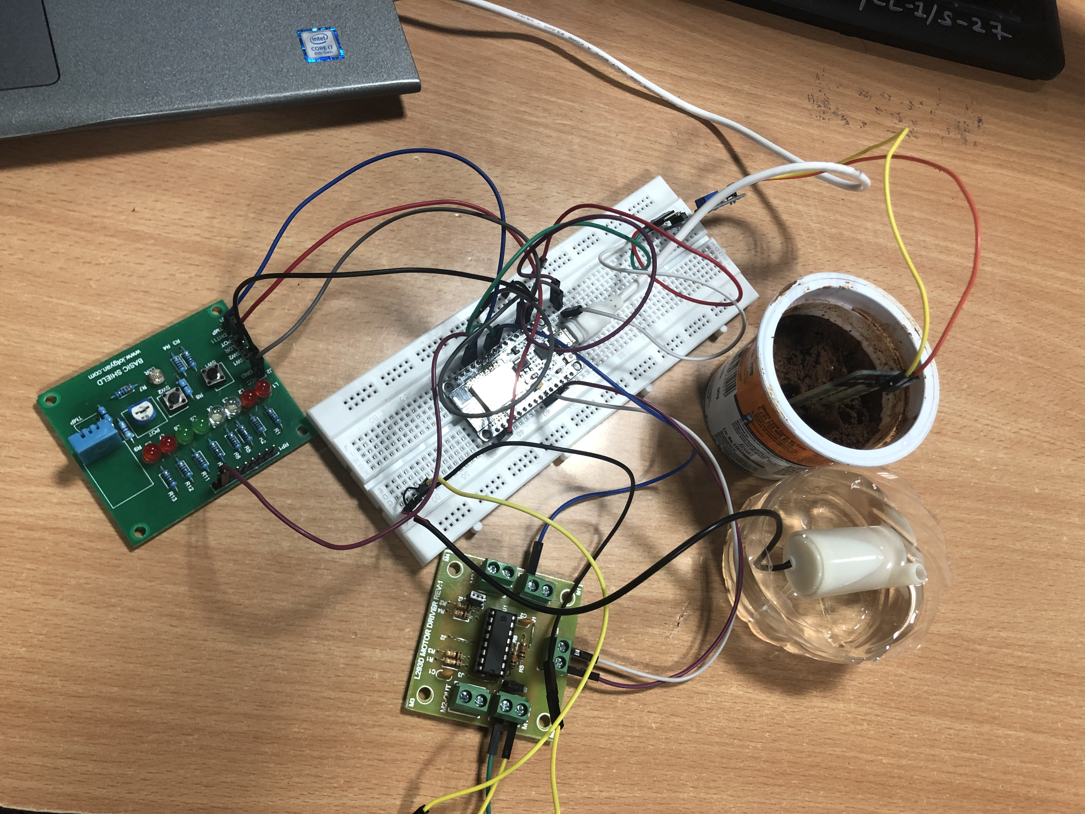
Green House Monitoring & Control System
using IBM Watson

Slide 2
What is Greenhouse Monitoring?
Greenhouses require the proper environmental conditions for optimal plant growth and health. Crops can be lost if the mixture of temperature, humidity, and light are incorrect. Monnit wireless sensors help farmers oversee and maintain the proper mix of atmospheric conditions.

Slide 3
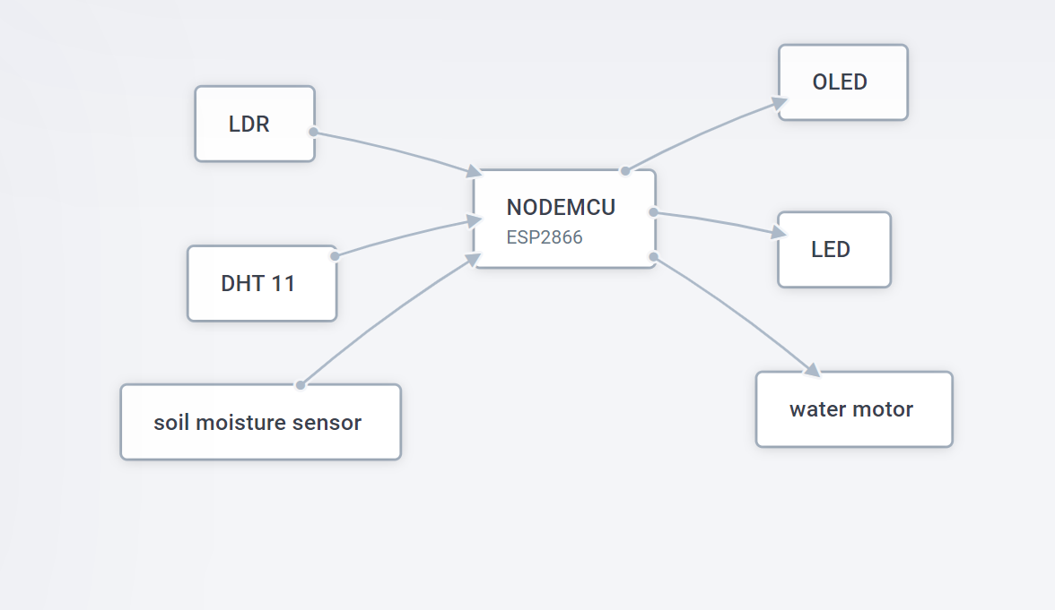
Components of Green House Monitoring & Control System

Slide 4
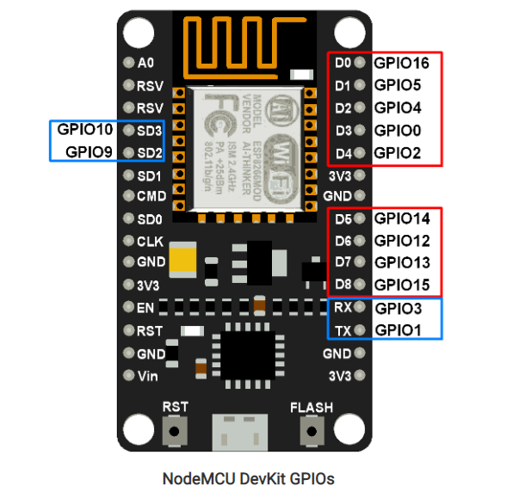
NODE MCU
The term NodeMCU usually refers to the firmware, while the board is called Devkit.
Node MCU Devkit 1.0 consists of an ESP-12E on a board, which facilitates its use.
It also has a voltage regulator, a USB interface
The ESP-12E is a board created by AI-THINKER, which consists of an ESP8266EX inside the metal cover.
Made by Espressif, this microchip has integrated WiFi and low-power consumption.
Processor RISC Tensilica L 106 32bit with a maximum clock of 160 MHz
The ESP8266 is a 3.3V microcontroller, so its I/O operates at 3.3V

Slide 5
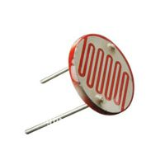
Light Dependent Resistor(LDR)
A Light Dependent Resistor (LDR) or a photo resistor is a device whose resistivity is a function of the incident electromagnetic radiation. Hence, they are light sensitive devices.
A light dependent resistor works on the principle of photo conductivity
LDR’s are light dependent devices whose resistance is decreased when light falls on them and that is increased in the dark. When a light dependent resistor is kept in dark, its resistance is very high. This resistance is called as dark resistance.
This Photo by Unknown Author is licensed under CC BY-SA

Slide 6
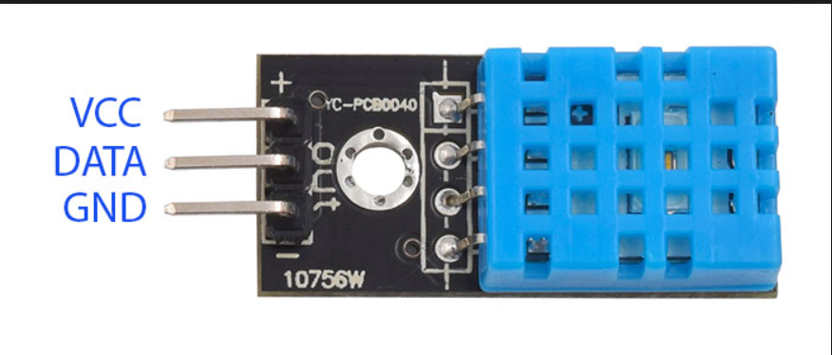
Digital Temperature and Humidity sensor.(DHT 11)
The DHT11 is a commonly used Temperature and humidity sensor. The sensor comes with a dedicated NTC to measure temperature and an 8-bit microcontroller to output the values of temperature and humidity as serial data.
DHT11 Specifications:
Operating Voltage: 3.5V to 5.5V
Operating current: 0.3mA (measuring) 60uA (standby)
Output: Serial data
Temperature Range: 0°C to 50°C
Humidity Range: 20% to 90%
Resolution: Temperature and Humidity both are 16-bit
Accuracy: ±1°C and ±1%
Working Principle:
Communication process can be separated into three stages
1. Request
2. Response
3. Data processing

Slide 7
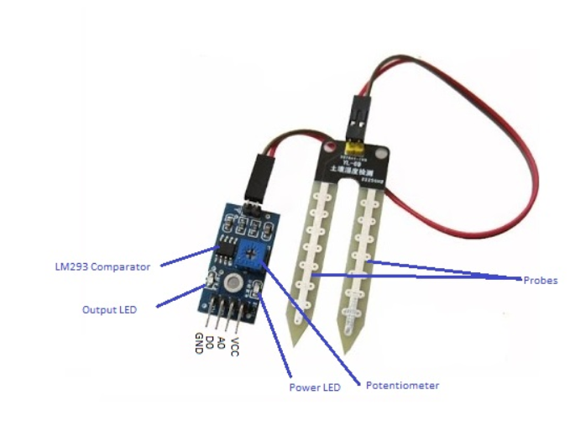
YL-38 Soil Moisture Sensor
This sensor measures the volumetric content of water inside the soil and gives us the moisture level as output.
Working of Sensor :
When there is more water, the soil will conduct more electricity which means that there will be less resistance. Therefore, the moisture level will be higher. Dry soil conducts electricity poorly, so when there will be less water, then the soil will conduct less electricity which means that there will be more resistance. Therefore, the moisture level will be lower.
Specifications:
Operating voltage: DC 3.3V - 5V
Output voltage signal: 0 ~ 4.2V
Current: 35mA
LED: Power indicator (Red) and Digital switching output indicator (Green)

Slide 8
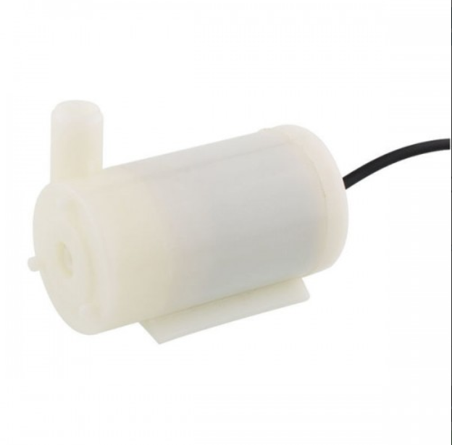
Submersible Mini Water Pump
Micro DC 3-6V Micro Submersible Pump Mini water pump For Fountain Garden Mini water circulation System
Working Principle:
The main principal behind the working of is the conversion of energy into mechanical energy and using it for providing the required pressure for pumping the water.
Specifications:-
Operating Voltage : 3 ~ 6V
Operating Current : 130 ~ 220mA
Flow Rate : 80 ~ 120 L/H
Maximum Lift : 40 ~ 110 mm
Continuous Working Life : 500 hours Driving Mode : DC, Magnetic Driving
Material : Engineering Plastic
Outlet Outside Diameter : 7.5 mm
Outlet Inside Diameter : 5 mm

Slide 9
WORKING OF THE PROTOTYPE
Arduino IDE was used to develop the code.
The soil moisture, available natural light, temperature and humidity are detected using various sensors.
This information is sent to the IBM Cloud which in turn sends it to NodeRED.
The Node RED UI displays the information and gives 6 options- Light ON, Light OFF, Light Automatic, Sprinkler ON and Sprinkler OFF.
Light ON , Light OFF, Sprinkler ON and Sprinkler OFF turn the respective components on or off indefinitely until another command is given.4
Light Auto detects the available natural light using LDR and changes the intensity of the LED light accordingly, i.e, when more sunlight is available, the intensity of the LED is less and vice versa. However, since all the plants need darkness for 8 hours, when Light AUTO command is given, LED is turned off from 8:00PM to 4:00AM.
Sprinkler Auto detects the soil moisture and when the moisture is less, it turns the sprinkler on. Else, the sprinkler is turned off.
When the temperature or/and humidity exceed the maximum optimum limit, a text notification is sent to the registered mobile number using msg91 urging the owner to check the greenhouse.

Slide 10
Benifits of Green House Monitoring
Maximize Revenue and Profits
Save Time and Resources
Protects Yields
Low Cost &Easy Installation
Monitor Anywhere , Anytime
Easy user interface

Slide 11
THANK YOU!

